Slide 1
Double Cut and Join with Insertions and Deletions
MARı´LIA D.V. BRAGA, EYLA WILLING, and JENS STOYE
JOURNAL OF COMPUTATIONAL BIOLOGY
September 2011
Ron Zeira
Group meeting, March 2013

Slide 2
Introduction to DCJ
Yancopoulos et al. 2005.
A unifying view of genome rearrangements.
Anne Bergeron, Julia Mixtacki, and Jens Stoye.
Given two genomes A and B (no duplications), the goal is to find a shortest sequence of rearrangement operations that transforms A into B.

Slide 3
Definitions
A gene is an oriented sequence of DNA that starts with a tail (3’) and ends with a head (5’).
a is a gene: a_{t} is the tail and a_{h} is the head.
adjacency of two consecutive genes a and b, depends on their respective orientation:
An extremity that is not adjacent to any other gene is called a telomere, represented by a singleton set : {a_{t}} or {a_{h}}.

Slide 4
Definitions
A genome is a set of adjacencies and telomeres such that the tail or the head of any gene appears in exactly one adjacency or telomere.
Chromosomes are either bounded by two telomeres or circular (no telomere).

Slide 5
Example

Slide 6
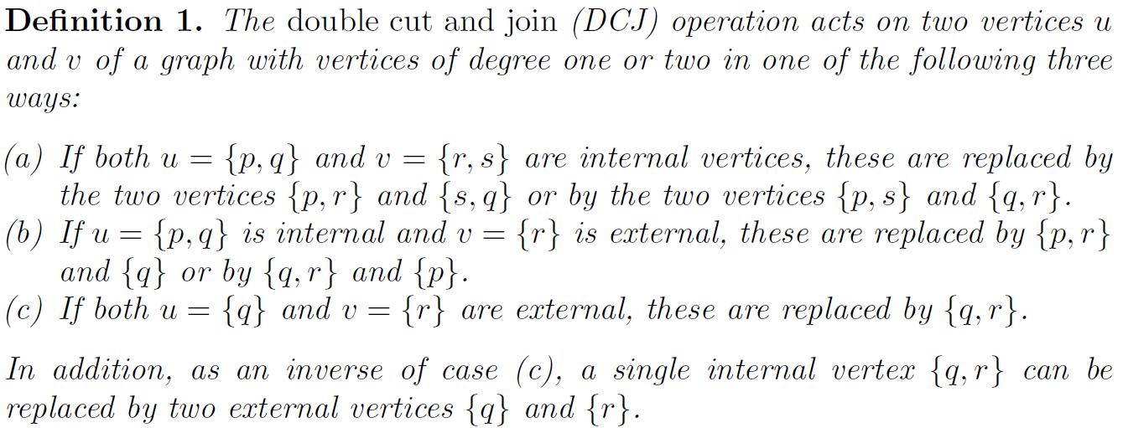
DCJ operation

Slide 7
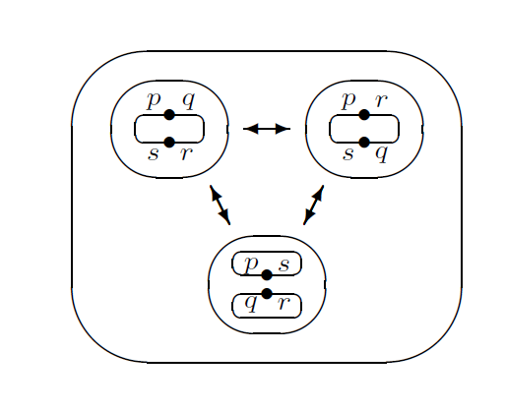

Slide 8
DCJ distance example

Slide 9
Adjacency graph
Notes:
Obviously, every vertex in the adjacency graph has degree one or two, therefore
it is a union of cycles and paths. Since the graph is bipartite, all cycles have
even length

Slide 10
DCJ distance
Notes:
Lemma 1. The application of a single DCJ operation changes the number of
circular or linear components by at most one.
Lemma 2. Let A and B be two genomes defined on the same set of N genes,
then we have
A = B if and only if N = C + I/2
where C is the number of cycles and I the number of odd paths in AG(A,B).
Lemma 3. The application of a single DCJ operation changes the number of
odd paths in the adjacency graph by –2, 0, or 2.
Lemma 4. Let A and B be two genomes defined on the same set of N genes,
then we have
dDCJ (A,B) N − (C + I/2)
where C is the number of cycles and I the number of odd paths in AG(A,B).

Slide 11
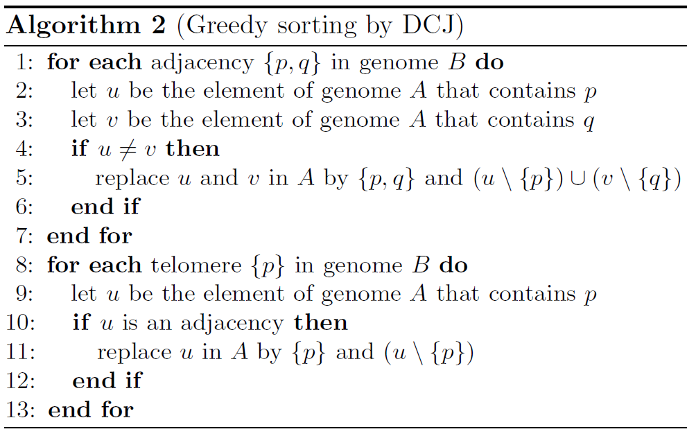

Slide 12
DCJ with indels
No duplications.
Allows DCJ operations.
Unequal genomes.
Allows insertions and deletions of multiple contiguous segments.
“◦” – represent a telomere.
Markers are separated into groups:

Slide 13
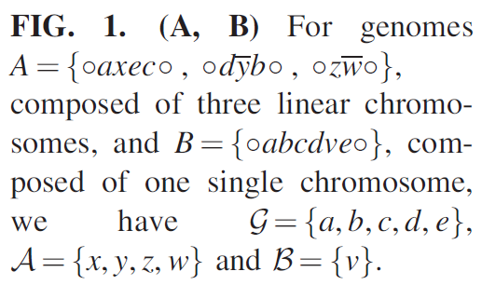
Example

Slide 14
l is a string of either A or B (or empty)
If l is non-empty, v is labeled o.w clean.

Slide 15
Operations
DCJ
Deletions
Insertions

Slide 16
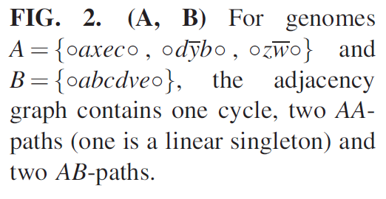
Adjacency graph

Slide 17
Problem defintion
The DCJ-indel distance of A and B is the minimum number of DCJ and indel operations required to transform A into B.

Slide 18
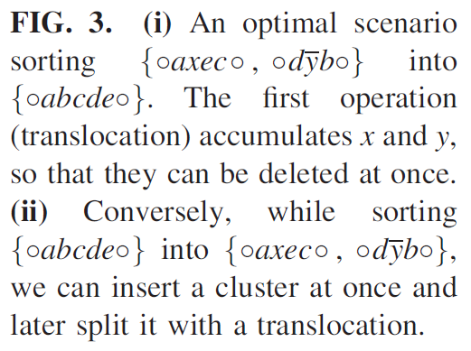
Accumulation

Slide 19
Runs
Run – maximal substring of markers of the same kind (A/B).
Λ(C) – number of runs in component C.

Slide 20
More results
The optimal DCJ (no indel) distance can be achieved by optimally sorting each component separately.
λ(C) - The indel-potential of component C is the minimum number of runs obtained by a separate optimal DCJ-sorting on C.

Slide 21
Better bound
We can sort each component separately with optimal DCJ operations + another λ(C).

Slide 22
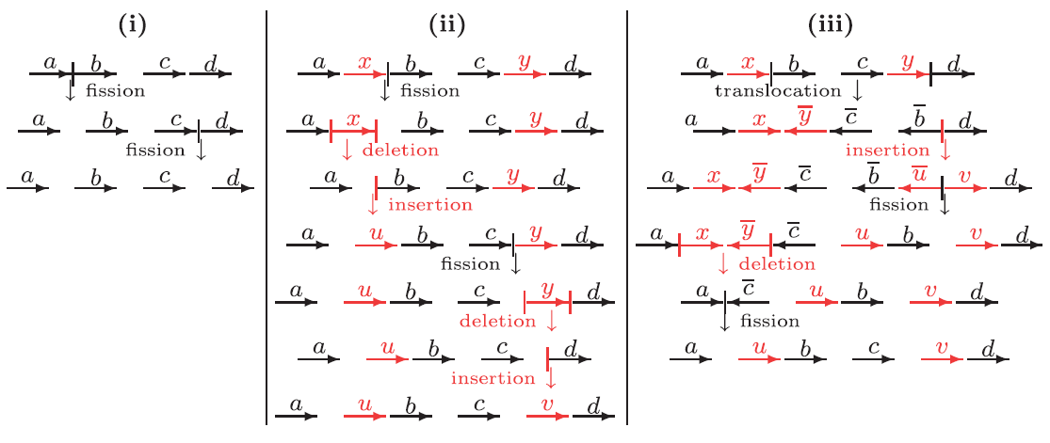
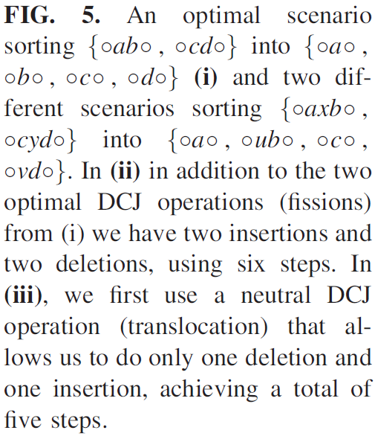
Not optimal

Slide 23
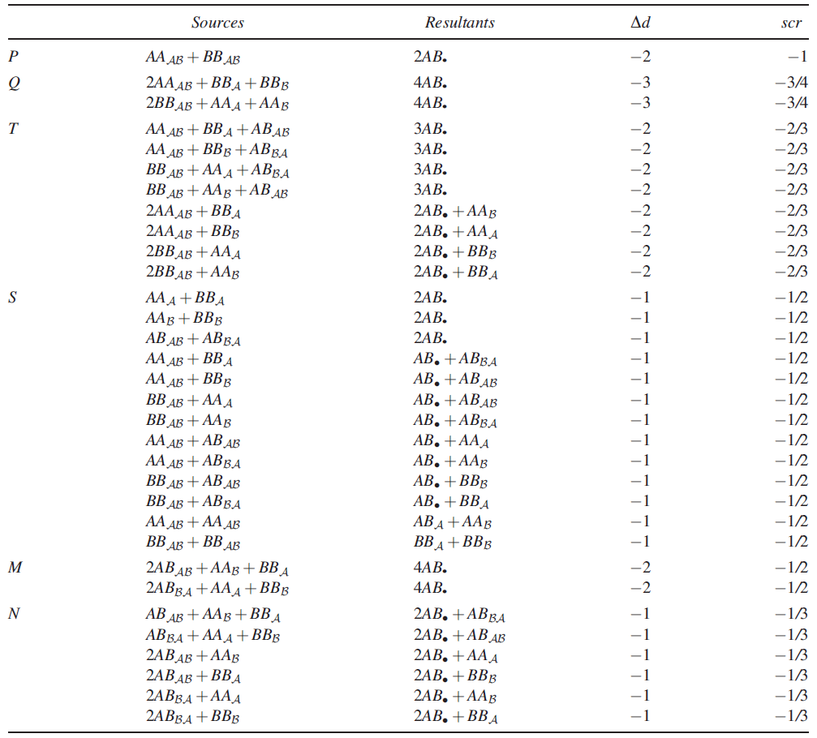

Slide 24
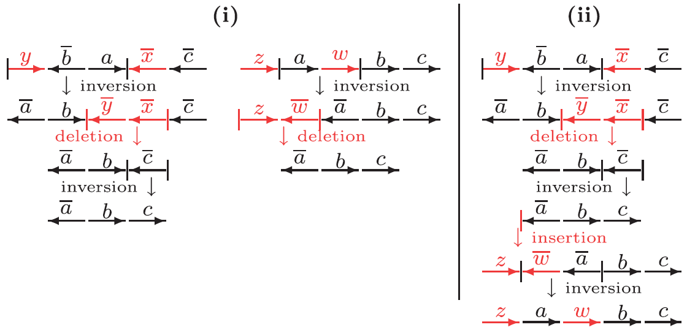
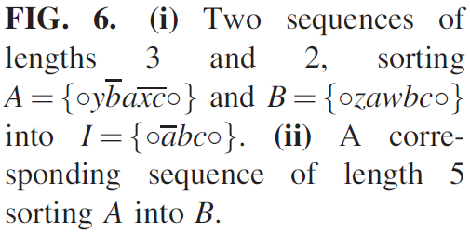
Backtracking

Slide 25
Algorithm

Slide 26
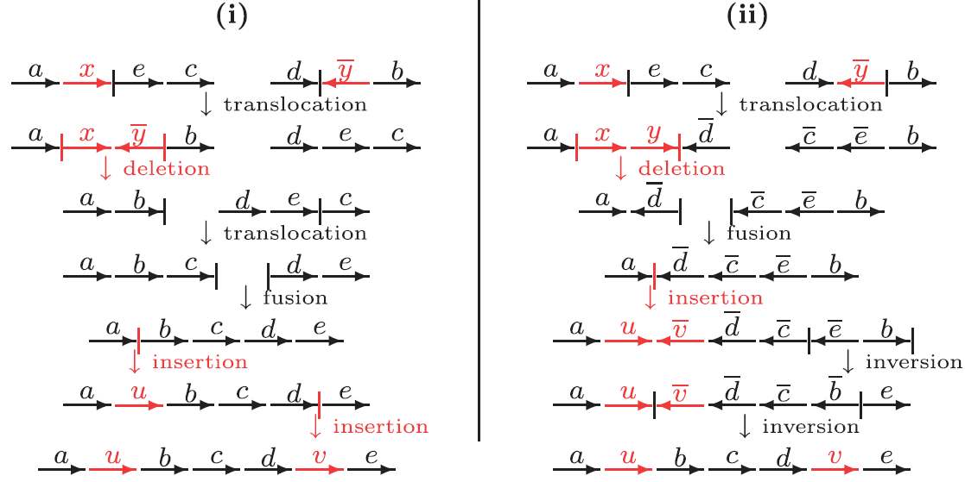
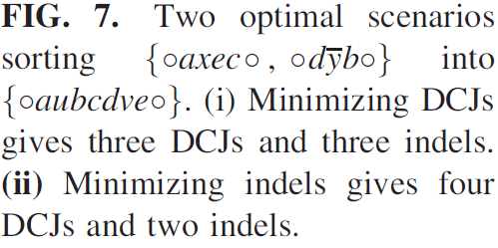
DCJs vs. Indels

Slide 27
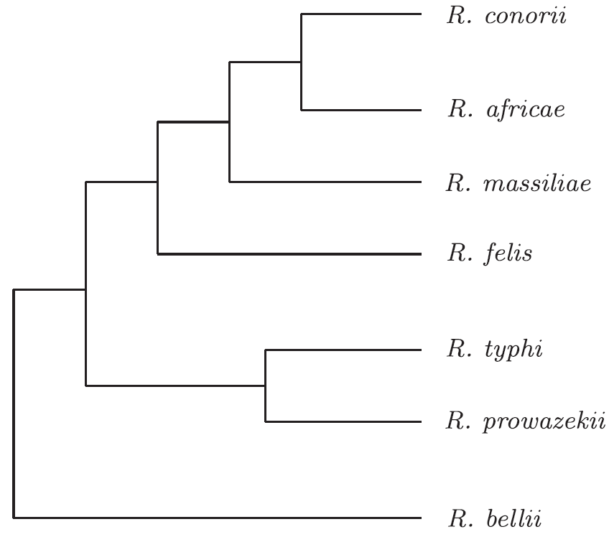
Experiments
Analyze the evolution of Rickettsia – parasites causing diseases such as typhus, spotted fever.
Closely related except for R. bellii with high level of rearrangement.

Slide 28
Results
Unique segments
Merged runs
Min #DCJ
Min #DCJ+indel
Runs

Slide 29
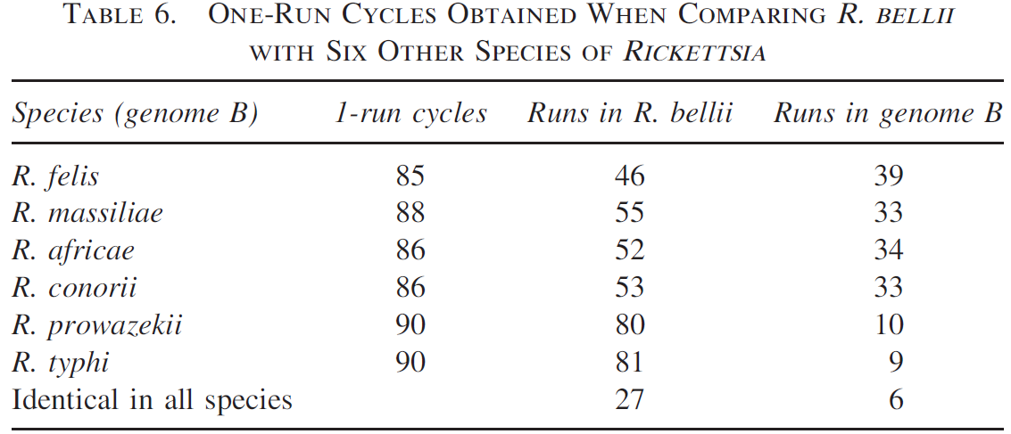
Results 2
1-run cycles: cannot be merged. Identifies deletions that occurred right after differentiation

Slide 30
Triangle inequality
Triangle inequality doesn’t hold.
For example:
Authors add surcharge to the distance to solve the problem.

